Slide 1





E-COMMERCE SALES
ANALYSIS
CAPSTONE PROJECT
Data Analytics with Advanced SQL | Power BI | MySQL | DAX | Visualization
PRESENTED BY VAIBHAV BAJPAI

Slide 2

About project
As a Data Analyst at Target Sales Company, my role is to analyze and extract valuable insights from a diverse dataset comprising orders, customers, products, regions, and operational metrics
The objective is to support the company's strategic decision-making by identifying key trends in sales performance, customer behavior, and operational efficiency.
This project covers advanced SQL data extraction and interactive dashboard creation in Power BI/Tableau, providing a comprehensive view of business performance.

Slide 3


Phase 1:
SQL Analysis – Advanced Queries

Slide 4
Sales Performance Analysis

Slide 5
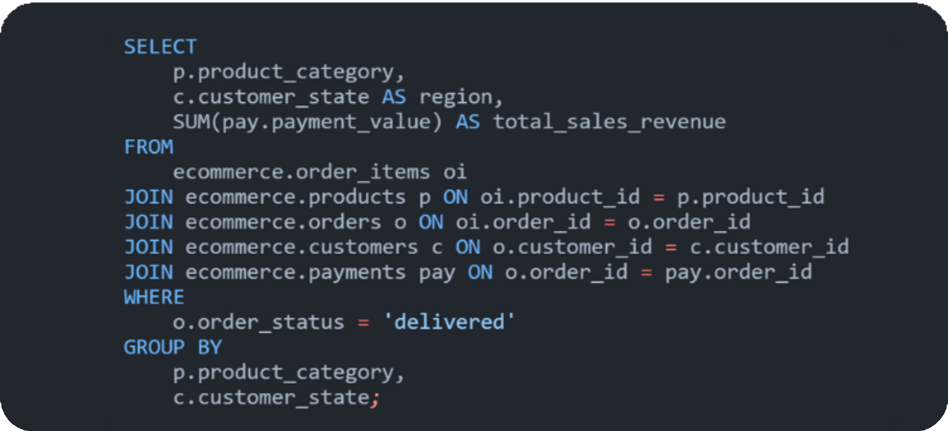
1
Write a query to calculate total sales revenue per category, sub-category, and region.

Slide 6
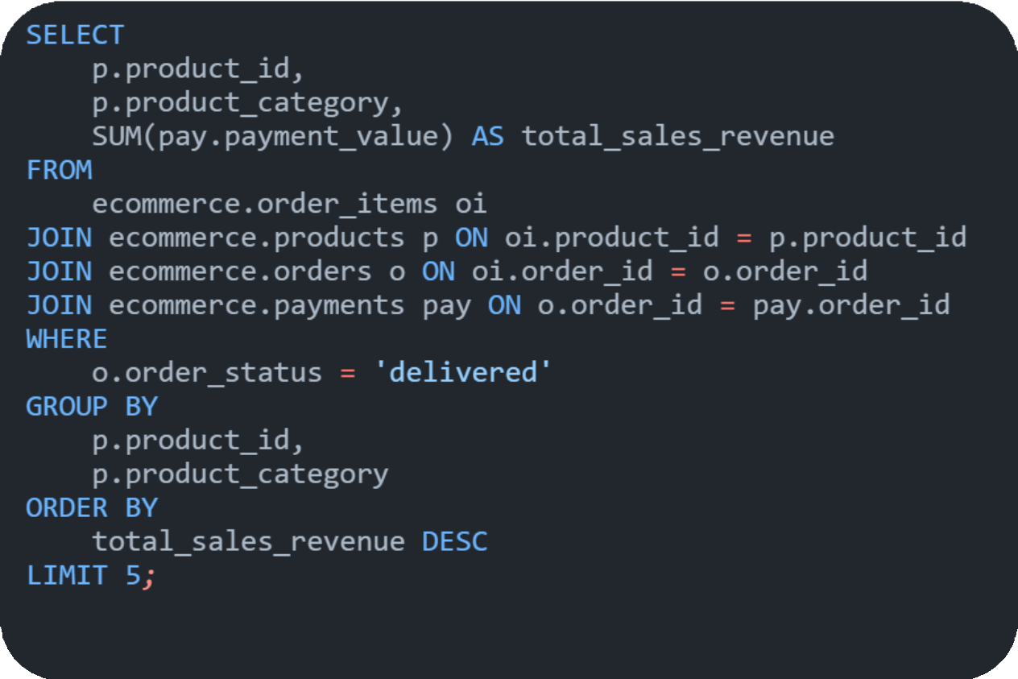
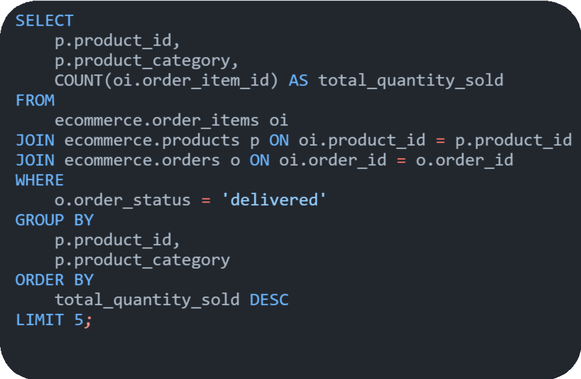
2
Identify the top 5 best-selling products by both sales revenue and quantity sold.

Slide 7
Customer Insights

Slide 8
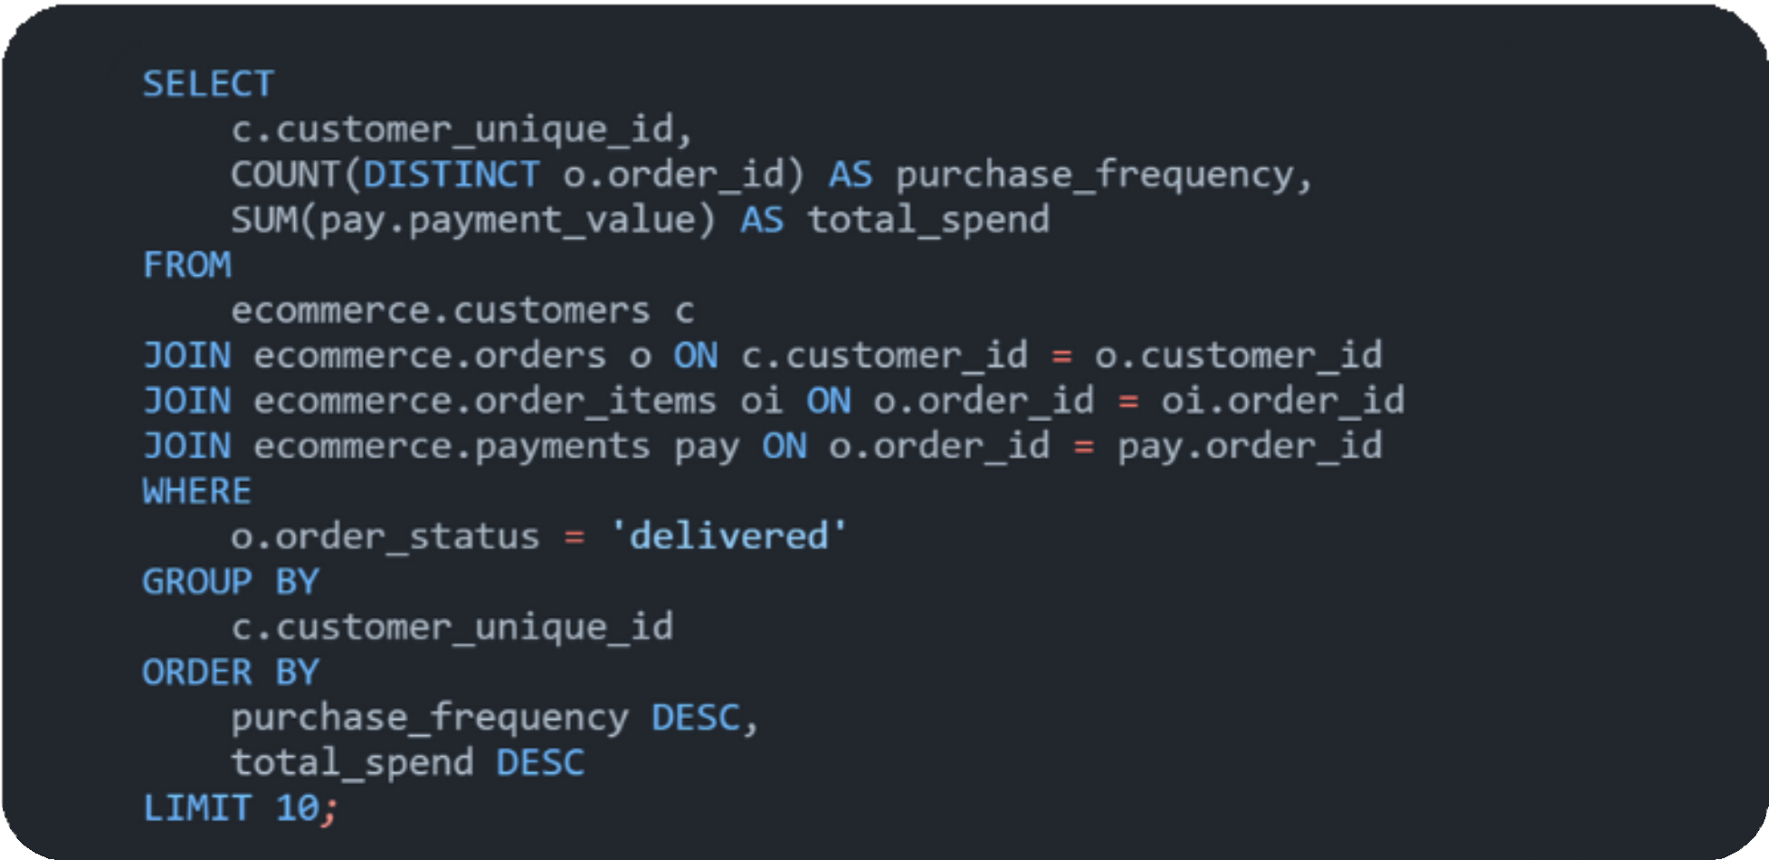
3
Find the most loyal customers by calculating their purchase frequency and total spend.

Slide 9
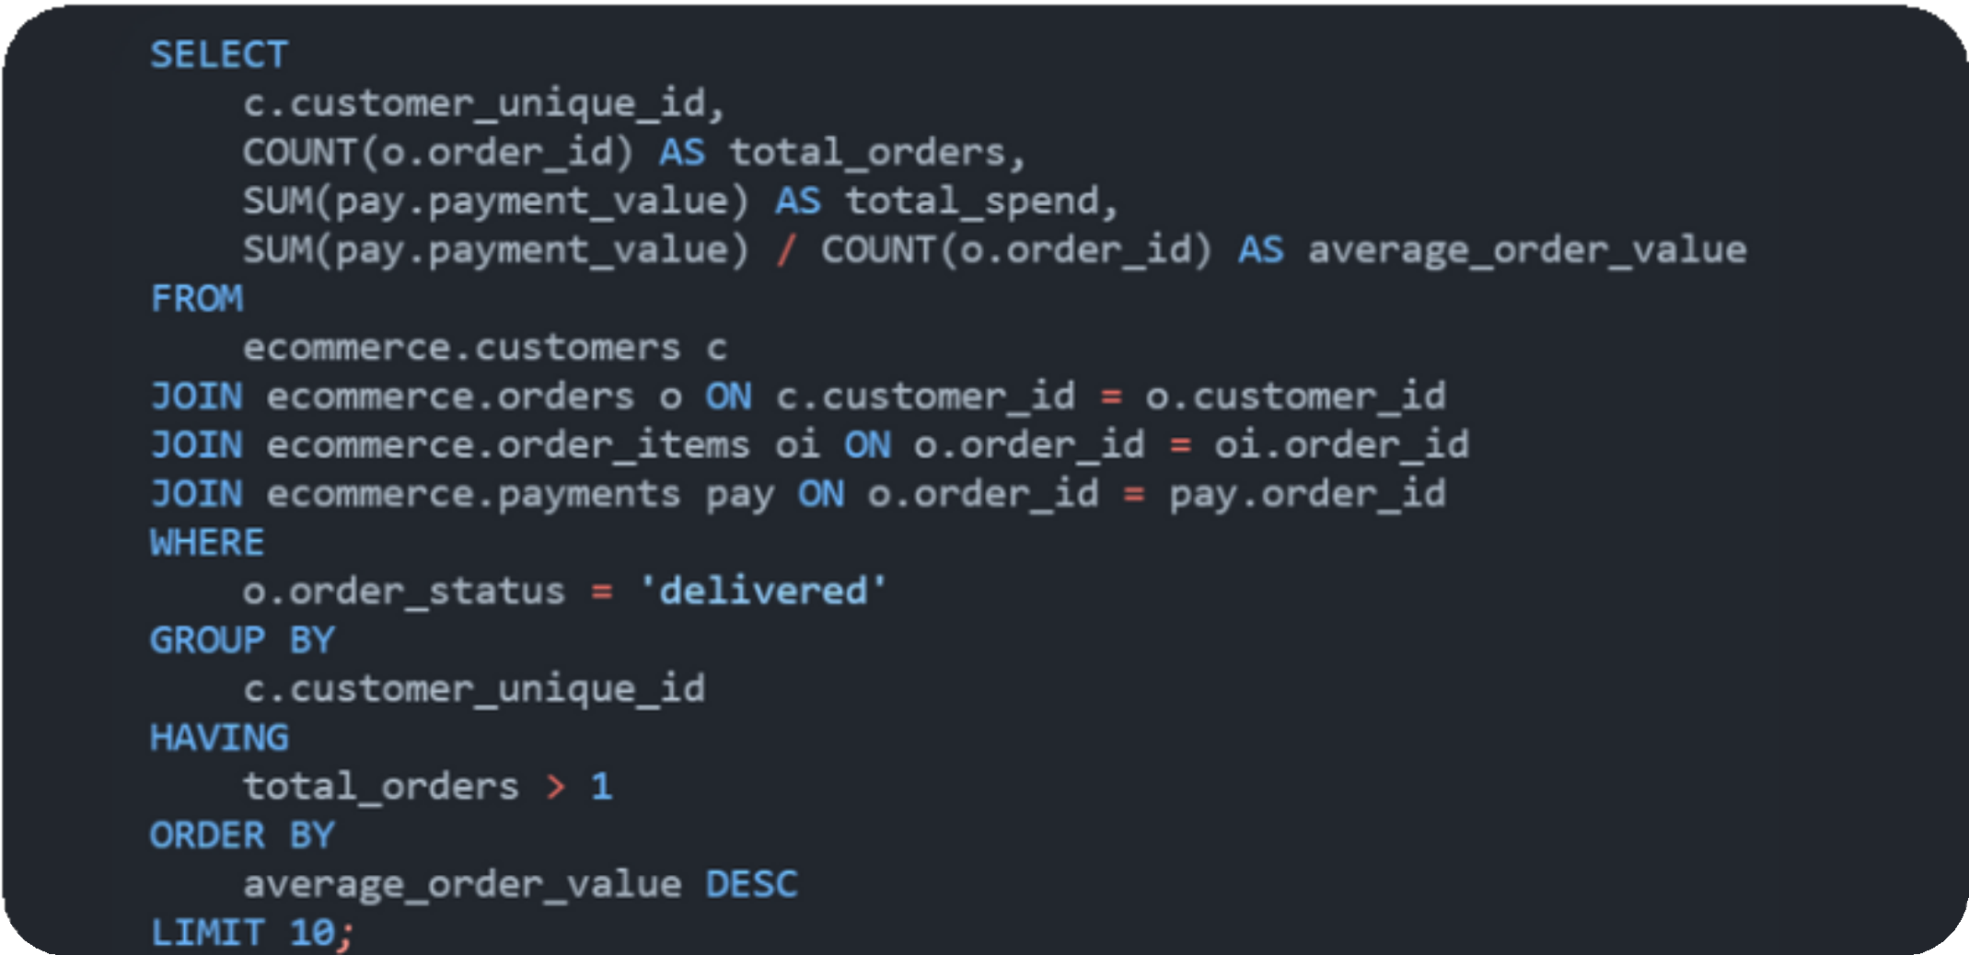
4
Identify customers with the highest average order value (AOV).

Slide 10
Operational Efficiency

Slide 11
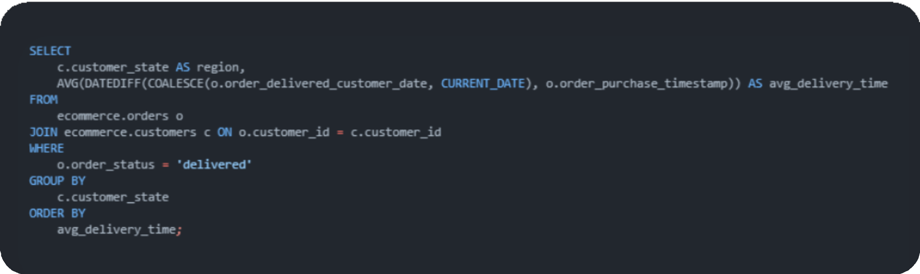
5
Analyze delivery performance by calculating the average delivery time by region.

Slide 12
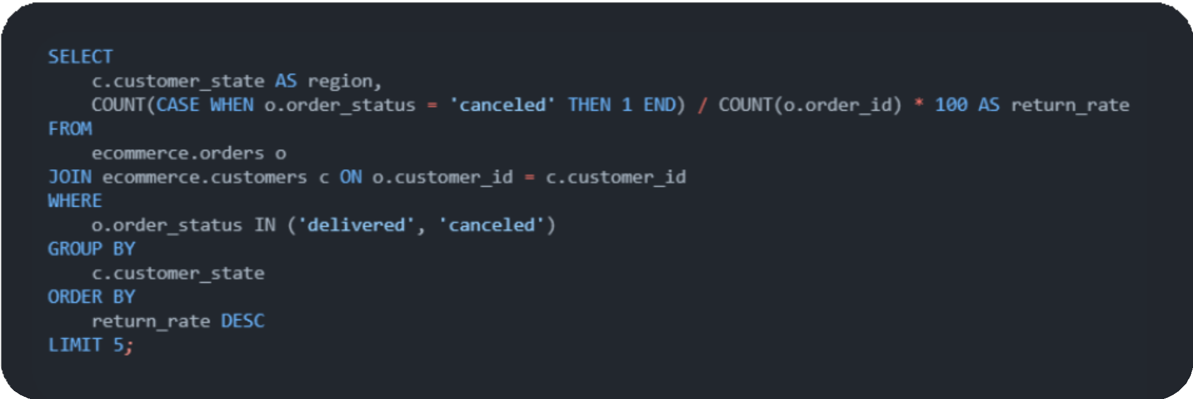
6
Identify regions or products with the highest cancelled rates.

Slide 13
Date and Time Analytics

Slide 14
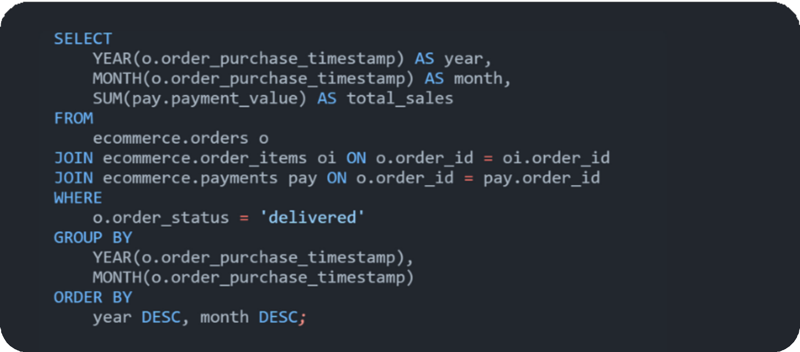
7
Write a query to find the monthly sales trend for the last two years.

Slide 15
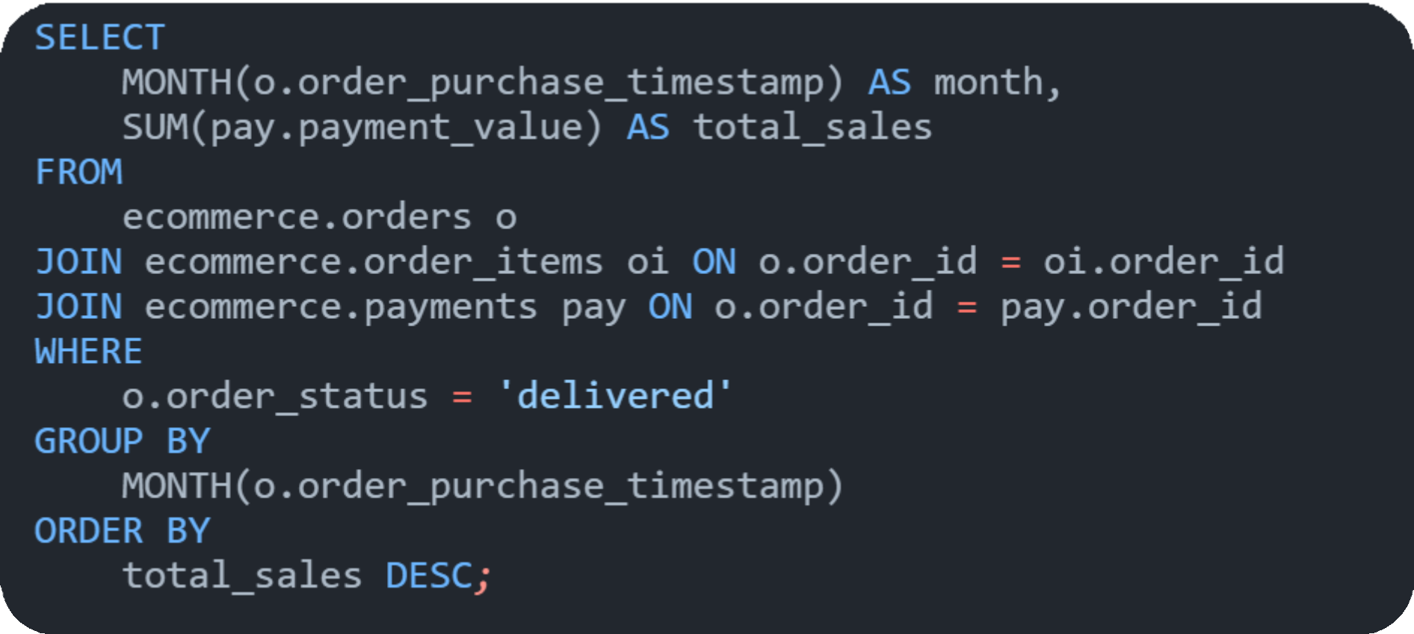
8
Analyze the seasonality of sales to identify peak months.

Slide 16
Advanced SQL QuerieS

Slide 17
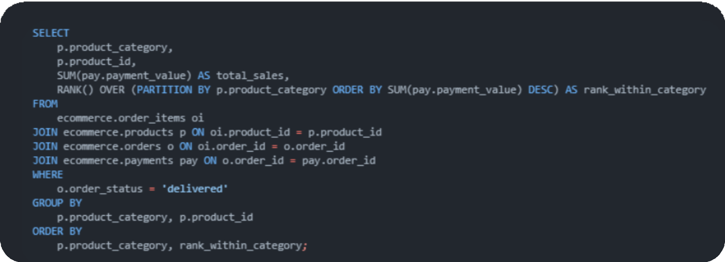
9
Use window functions to rank products based on their sales within each category.

Slide 18
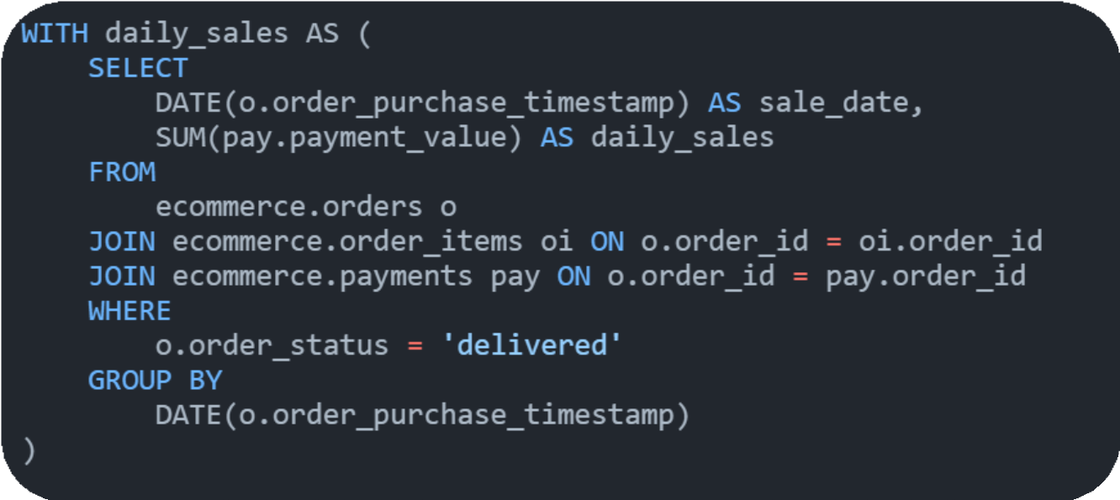
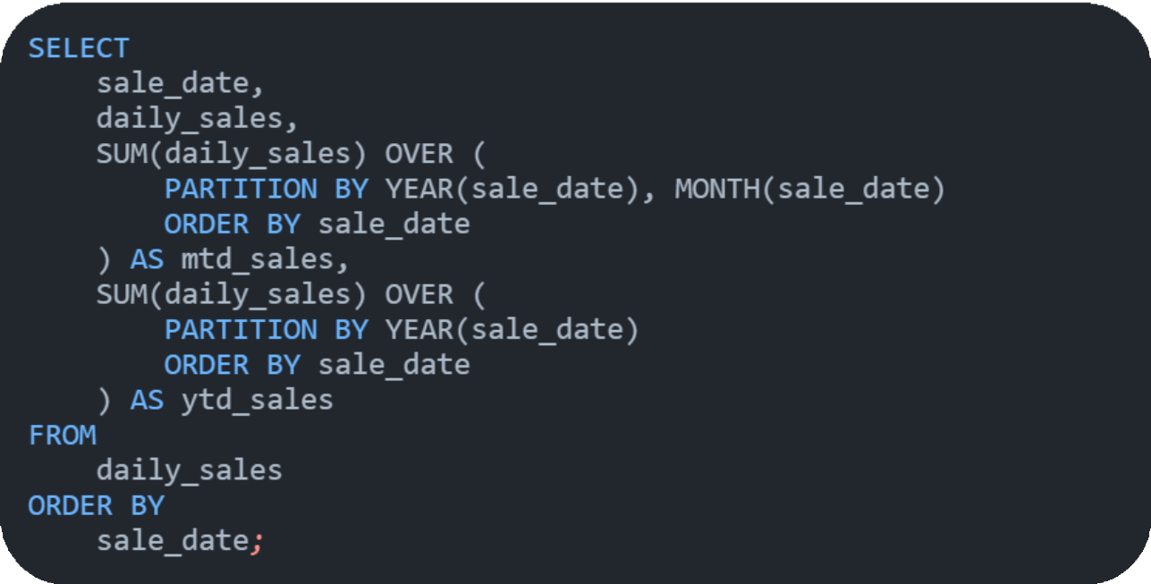
10
Calculate month-to-date (MTD) and year-to-date (YTD) sales metrics.

Slide 19



Phase 2: Data Visualization
– Power BI

Slide 20
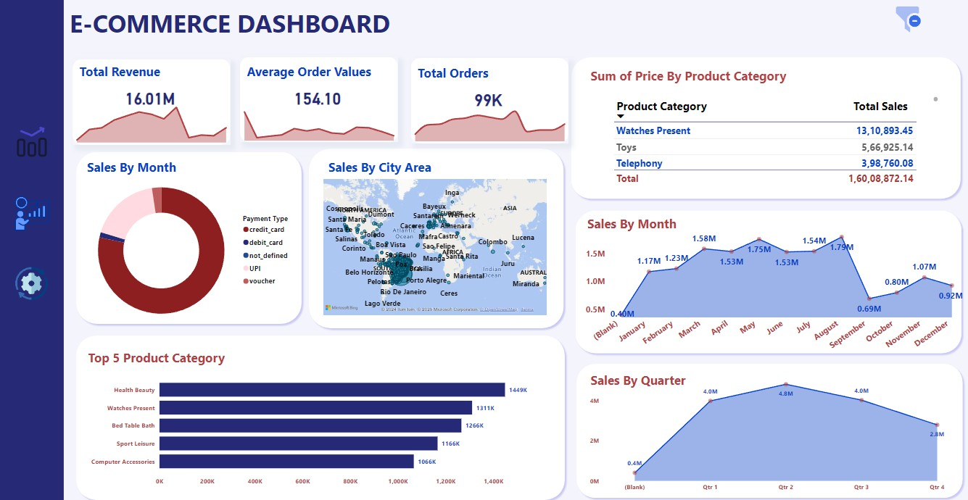
Sales Performance Dashboard

Slide 21
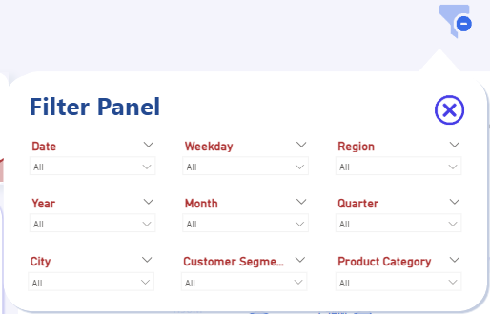
Added an Interactive Filter Panel button to simplify navigation and enhance user experience

Slide 22
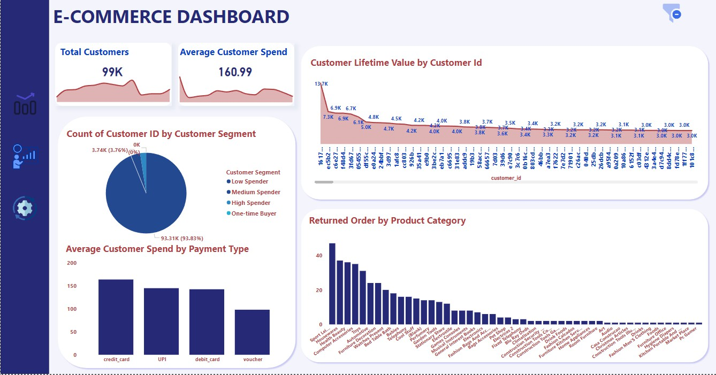
Customer Insights Dashboard

Slide 23
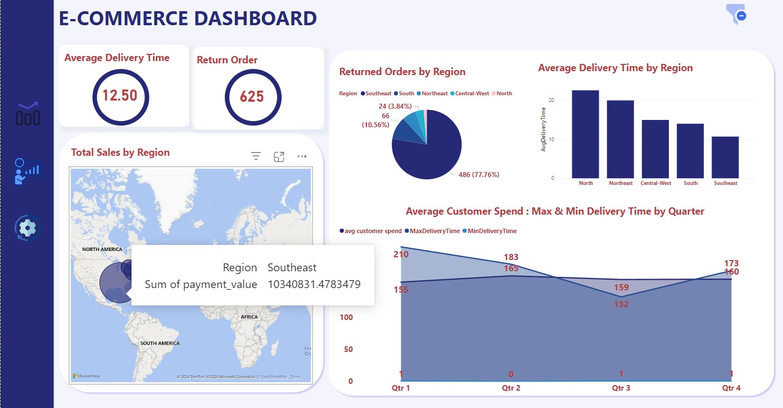
Regional & Operational Trends Dashboard

Slide 24

Phase 3:
E-Commerce Sales Performance Insights Report

Slide 25
Executive Summary
As a Data Analyst at Target Sales Company, I have conducted an in-depth analysis of the company's sales data to uncover key insights and provide actionable recommendations. The analysis focused on sales performance, customer behavior, regional trends, and operational metrics. The findings are presented through an interactive dashboard created in Power BI providing stakeholders with a clear view of business performance and opportunities for optimization.
The analysis covered various critical areas such as Sales Performance, Customer Behavior, Operational Metrics to help stakeholders understand what drives sales, who the key customers are, and how to improve operational efficiency.
Key areas of focus:
Sales Performance Trends
Customer Lifetime Value (CLV) & Segmentation Regional Sales & Return Analysis
Operational Metrics & Delivery Time Analysis Seasonality & Monthly Sales Trends
The report outlines key findings and provides actionable recommendations to improve business performance, customer satisfaction, and operational efficiency.

Slide 26
1. Sales Performance Insights
Sales peaked in July ($1.7M), but Q4 shows a significant decline, with December being the lowest-performing month ($0.88M).
This drop highlights seasonal declines and missed opportunities for Q4 holiday promotions, which could have boosted revenue during the festive season.
Quarterly Trends: Q2 was the highest-performing quarter, generating $5.1M in sales, while Q4 had the lowest contribution ($2.7M).
This indicates seasonality trends that can be leveraged to optimize marketing strategies during peak seasons.
Health & Beauty remains the top-performing category with $1.45M in sales, maintaining steady demand even during off-peak months.
This consistency suggests that investing in this category through promotions, bundling, and product expansion could further drive revenue.
Average Order Value (AOV) stands at $154.10.
The AOV indicates moderate purchasing behavior, which can be improved by offering personalized product recommendations and upselling opportunities.

Slide 27
2. Customer Insights
93.83% of customers are low spenders, making small, infrequent purchases.
The customer base is predominantly low-value, suggesting that most buyers are price-sensitive. Actionable Insight: Implement loyalty programs, bundle deals, and discount campaigns to increase customer lifetime value.
Customer Lifetime Value (CLV): The highest CLV is $13.7K, driven by a small group of loyal customers. These high-value customers contribute significantly to overall revenue.
Actionable Insight: Focus on retaining high-value customers through personalized offers, exclusive benefits, and priority services
Returned Orders are highest in the "Sport & Leisure" and "Housewares" categories, with 47 and 37 returns, respectively.
This indicates potential quality issues or misalignment with customer expectations in these categories. Actionable Insight: Improve product descriptions, conduct quality checks, and review return policies to reduce return rates.

Slide 28
3. Regional & Operational Insights
The North region dominates sales, contributing 64.59% of the total payment value ($10.34M).
This indicates that the North region is a key market, but it also has the highest average delivery time (22.5 days), which could affect customer satisfaction.
The Southeast region has the shortest average delivery time at 10.7 days.
This region's operational model can serve as a benchmark for improving delivery times across other regions.
Average Delivery Time increased significantly in Q2, with a max delivery time of 210 days.
This spike suggests logistical inefficiencies during peak periods, possibly due to high order volumes or resource shortages.
Actionable Insight: Review warehouse operations, partner with local couriers, and allocate more
resources during peak periods to improve delivery performance.

Slide 29
Recommendations for Stakeholders
Implement Holiday Promotions and Marketing Campaigns in Q4:
The sales decline in Q4 highlights missed opportunities for holiday promotions. Running discount campaigns and festive offers in Q4 can help boost revenue during slower months.
Launch a Customer Loyalty Program:
The data shows that a small subset of high-value customers drives a significant portion of revenue. Implementing a loyalty program targeting these customers can improve customer retention and lifetime value.
Focus on Health & Beauty Category Promotions:
The Health & Beauty category shows steady demand even during off-peak periods. Focus on expanding this product line, bundling products, and offering targeted promotions to maximize revenue.

Slide 30
Address Product Return Rates:
Returned orders are highest in the "Sport & Leisure" and "Housewares" categories. Conduct product quality checks and improve product descriptions to reduce return rates.
Optimize Delivery Operations in the North Region:
The North region contributes the most revenue, but it has the longest average delivery time (22.5 days). Action Steps:
Establish regional warehouses to reduce shipping times.
Partner with local courier services to improve delivery efficiency.
Track delivery performance and allocate more resources during peak times to avoid delays.
Upsell and Cross-Sell to Increase Average Order Value (AOV):
The AOV is $154.10, indicating moderate purchasing behavior. To increase this: Recommend complementary products during checkout.
Offer bundle deals to encourage customers to buy more. Personalize offers based on customer purchase history.

Slide 31
Conclusion
The E-Commerce Sales Dashboard provides valuable insights into sales performance, customer behavior, and operational efficiency. By addressing seasonal trends, customer engagement, and operational bottlenecks, the company can boost revenue, improve customer satisfaction, and enhance overall efficiency.
Key areas of focus include:
Launching loyalty programs to retain high-value customers. Introducing targeted promotions during off-peak months.
Improving delivery times in the North region to enhance customer satisfaction.
Addressing return rates to reduce operational losses.
These recommendations, if implemented effectively, can help Target Sales Company drive growth, enhance operational efficiency, and improve customer loyalty

Slide 32

GET IN TOUCH
WITH ME!
Protfolio
Github
LinkedIn

